Slide 1
Exploring the Benefits of Using Artificial Intelligence for Senior Citizens
Enhancing independence and quality of life with AI support
Notes:
AI-generated content may be incorrect. --- This presentation explores how artificial intelligence (AI) technologies can enhance the lives of senior citizens. We will examine how AI supports daily living, health and wellness, social connections, and caregiving to improve independence and quality of life for seniors.

Slide 2
Agenda Highlights
Enhancing Daily Living and Independence
Improving Health and Wellness
Facilitating Social Connections and Mental Stimulation
Supporting Caregivers and Family Members
Notes:
We will cover four main areas: enhancing daily living and independence, improving health and wellness, facilitating social connections and mental stimulation, and supporting caregivers and family members with AI solutions.

Slide 3
Enhancing Daily Living and Independence with Artificial Intelligence.
CARING FOR SENIOR CITIZENS
Notes:
AI offers tools that help seniors maintain independence and increase safety at home. Smart home devices, voice assistants, and automated reminders simplify everyday tasks and promote convenience.

Slide 4
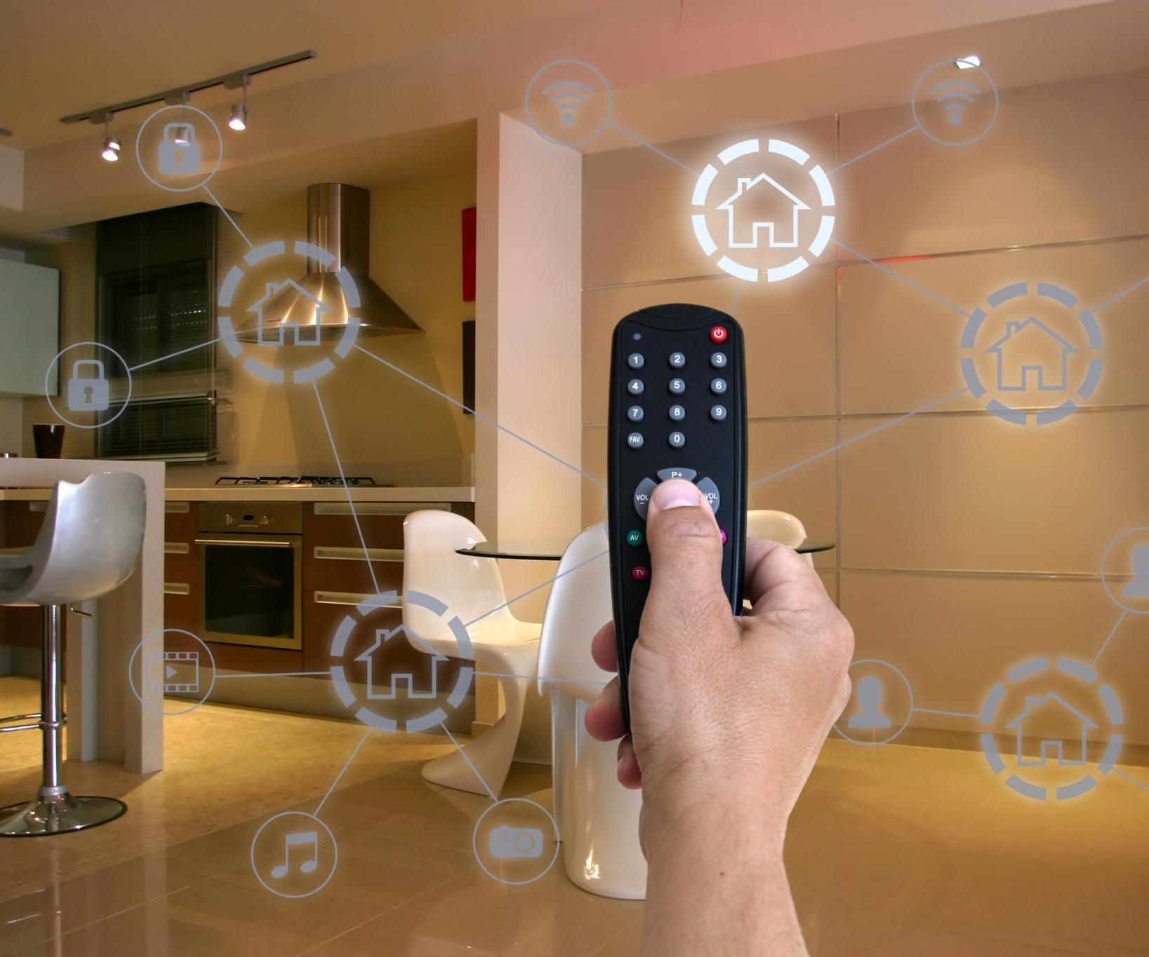
Smart Home Devices for Safety and Convenience
Hazard Detection
Smart devices detect hazards such as smoke, gas leaks, and obstacles to enhance home safety for seniors.
Automated Lighting Control
Automated lighting adjusts brightness and timing to prevent accidents and improve visibility at home.
Temperature Regulation
Smart thermostats maintain comfortable temperatures, ensuring convenience and safety for elderly residents.
Notes:
--- Smart home technologies can detect hazards, control lighting and temperature, and automate household functions to create a safer environment for seniors, reducing risks like falls or accidents. Image source: Microsoft 365 content library

Slide 5
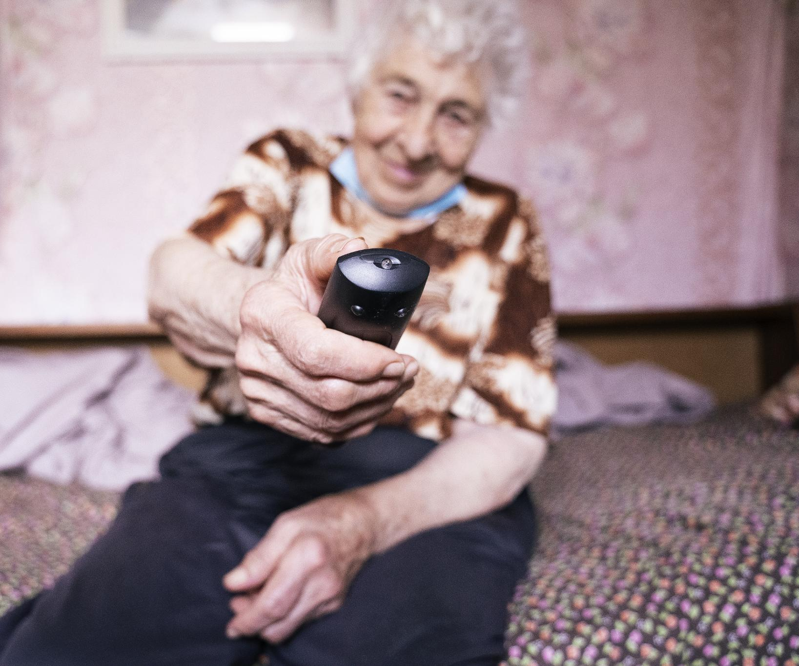
Voice Assistants for Easier Communication
Hands-Free Task Management
Voice assistants allow seniors to manage calls, messages, and smart devices without manual effort.
Support for Mobility Challenges
Voice-activated AI aids seniors with limited mobility by simplifying access to technology.
Assistance for Vision Impairment
Voice assistants help seniors with vision difficulties by enabling interaction without screens.
Notes:
--- Voice-activated AI assistants enable seniors to perform tasks hands-free, such as making calls, sending messages, or controlling devices, which aids those with mobility or vision difficulties. Image source: Microsoft 365 content library

Slide 6
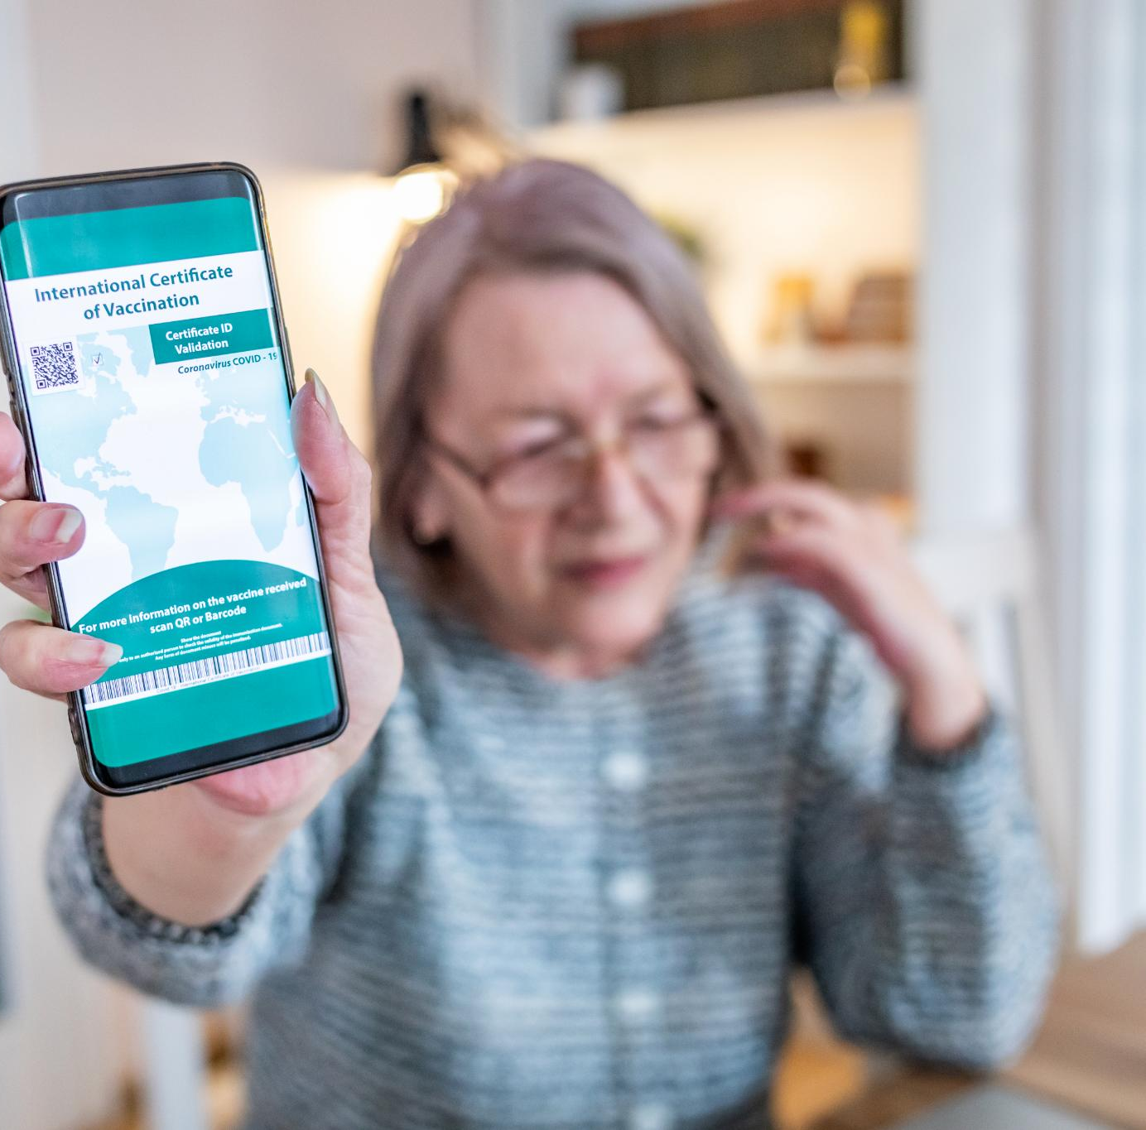
Automated Reminders for Medication and Appointments
AI Reminder Systems
AI-driven reminder systems assist seniors in tracking medication schedules efficiently and reliably every day.
Improved Treatment Adherence
Automated reminders increase seniors' adherence to prescribed treatments and reduce missed doses.
Appointment Management
These systems also help seniors remember important appointments, minimizing missed commitments and improving wellbeing.
Notes:
--- AI-powered reminder systems help seniors remember medication schedules and important appointments, improving adherence to treatments and reducing missed commitments. Image source: Microsoft 365 content library

Slide 7
Improving Health and Wellness
ARTIFICAL INTELLIGENCE IN ACTION
Notes:
AI technologies play a significant role in monitoring health and promoting wellness through wearable devices, telemedicine, and personalized fitness programs tailored for seniors.

Slide 8
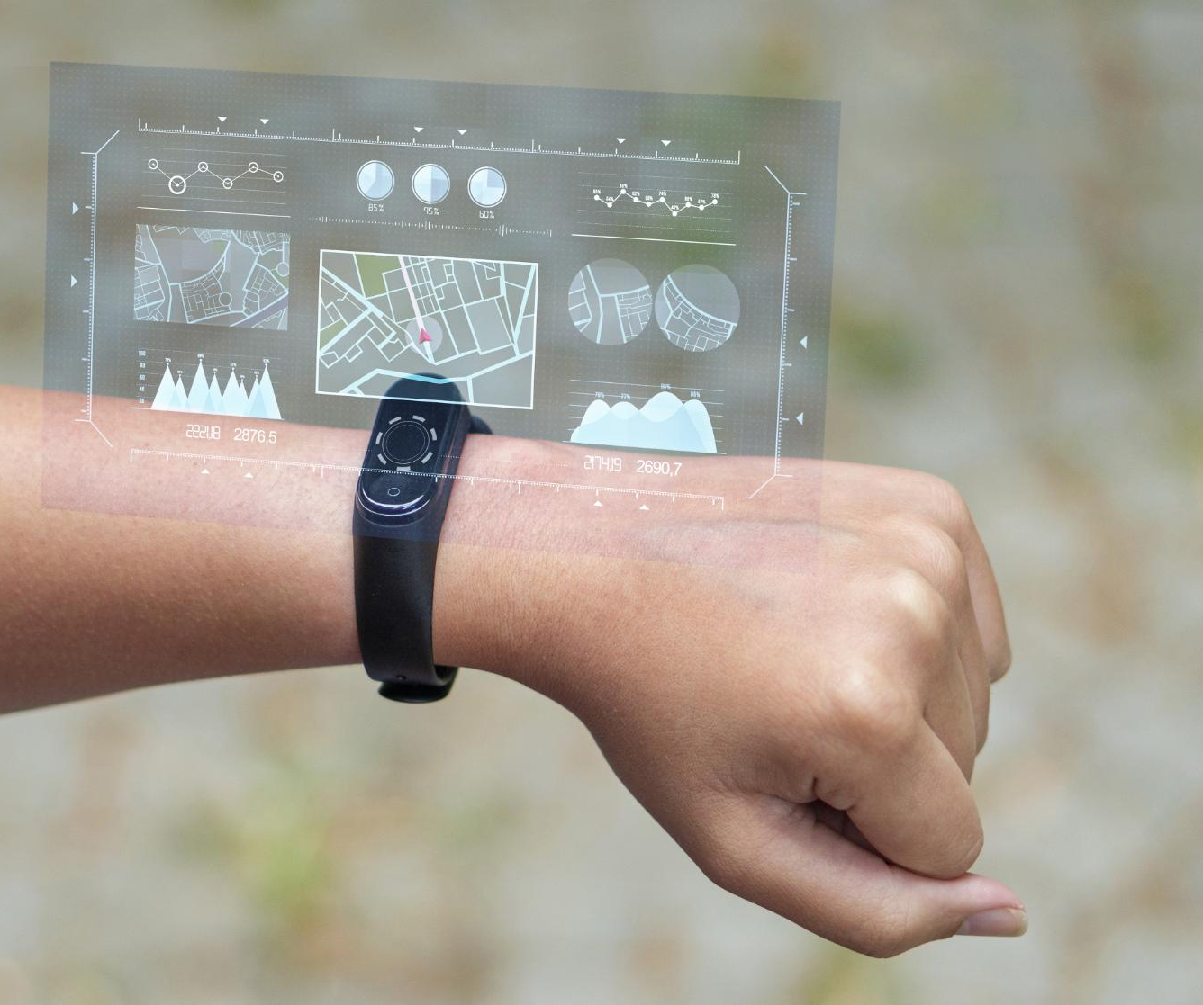
AI-Powered Health Monitoring and Wearable Devices
AI-Enabled Vital Sign Tracking
AI-powered wearables continuously monitor vital signs like heart rate and blood pressure for early health anomaly detection.
Early Health Intervention
AI detects health anomalies early, enabling timely intervention and preventing serious chronic condition complications.
Chronic Condition Management
Wearables support continuous health monitoring, improving care for chronic diseases common in older adults.
Notes:
--- Wearables equipped with AI track vital signs and detect anomalies, enabling early intervention and continuous health monitoring for chronic conditions common in older adults. Image source: Microsoft 365 content library

Slide 9
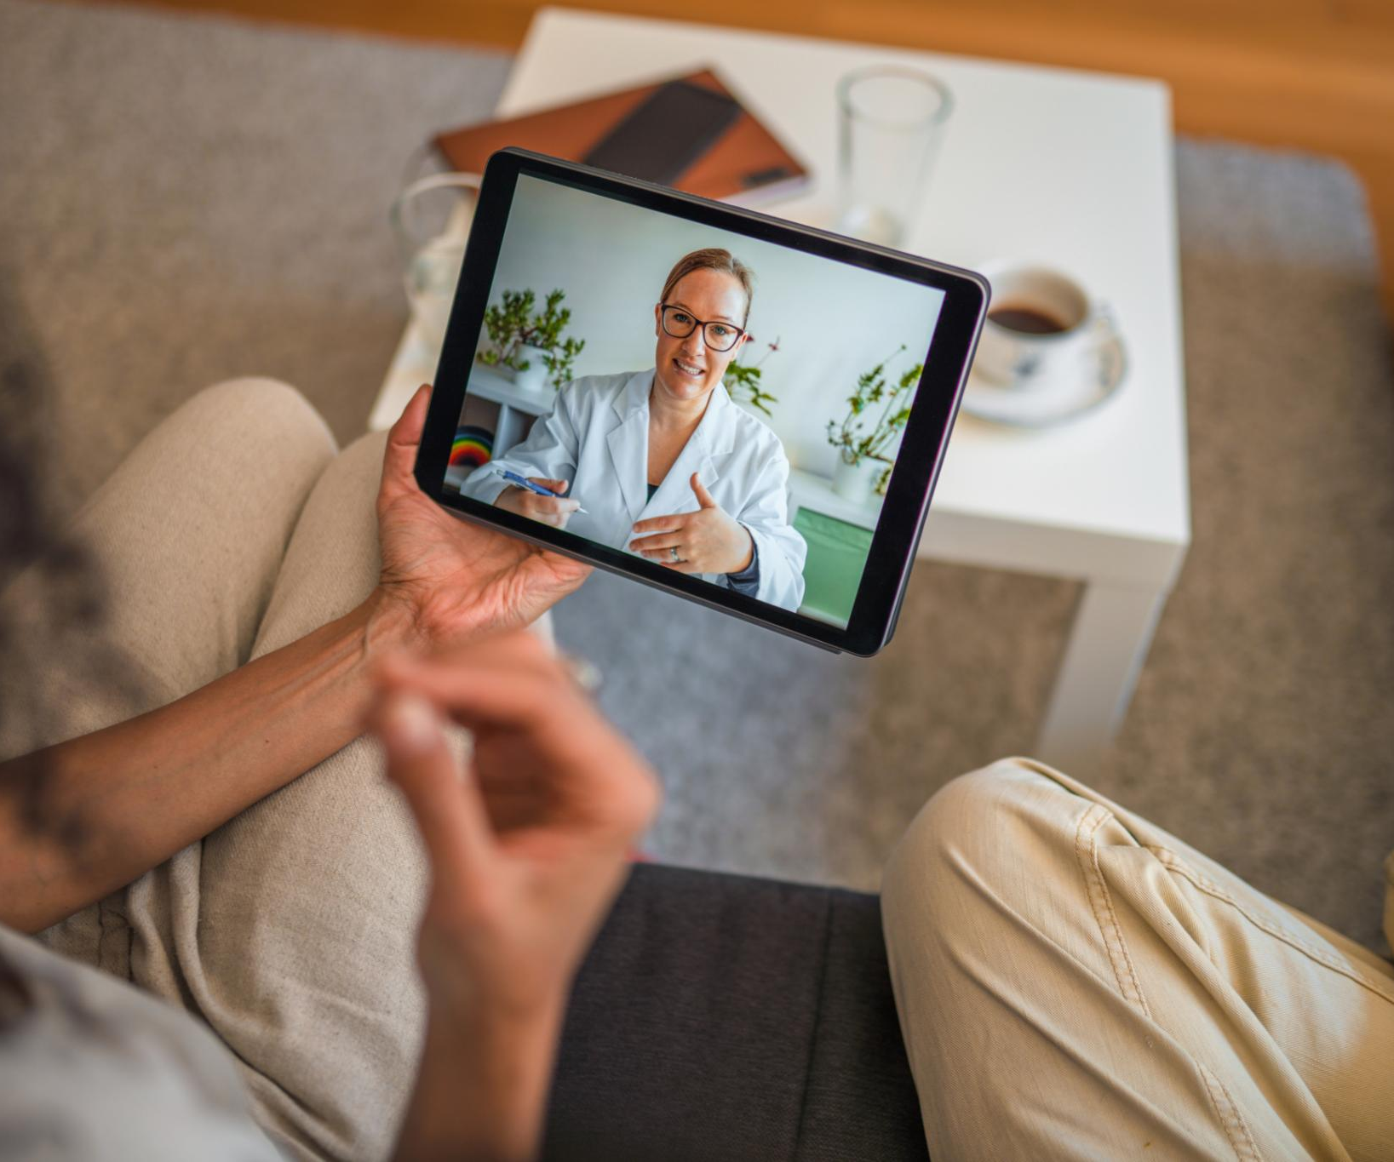
Remote Consultations and Telemedicine
AI-Powered Telemedicine
AI enhances telemedicine platforms, enabling efficient and accurate remote doctor visits for patients.
Accessibility for Seniors
Remote consultations improve healthcare accessibility and convenience for seniors with mobility challenges.
Notes:
--- Telemedicine platforms powered by AI facilitate remote doctor visits, making healthcare more accessible and convenient for seniors who may face mobility challenges. Image source: Microsoft 365 content library

Slide 10
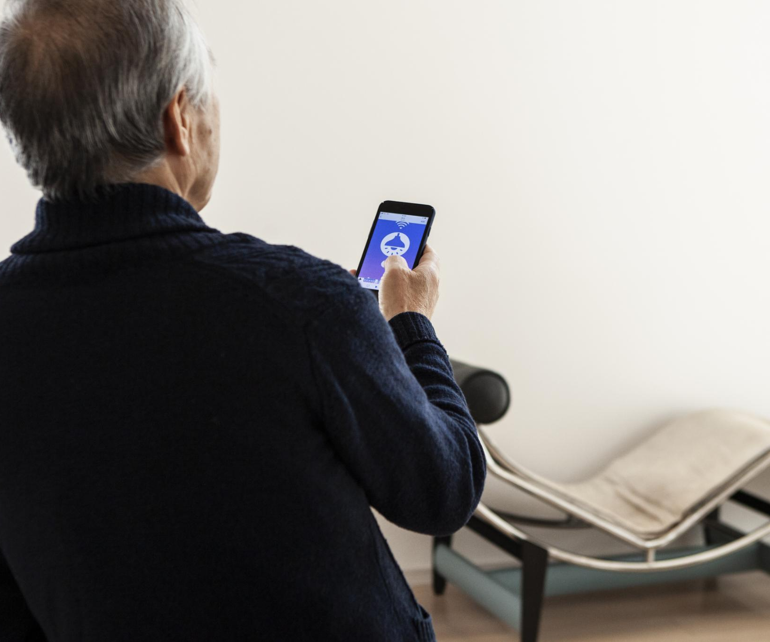
Personalized Fitness and Wellness Programs
Customized Exercise Plans
AI creates tailored exercise routines that match seniors’ abilities and fitness goals effectively.
Adaptive Wellness Programs
Wellness programs adapt dynamically to changing health needs and encourage sustained physical activity.
Encouraging Healthy Lifestyles
Personalized programs motivate seniors to maintain active and healthy lifestyles consistently over time.
Notes:
--- AI can design customized exercise and wellness routines that adapt to seniors’ abilities and goals, encouraging physical activity and healthy lifestyles. Image source: Microsoft 365 content library

Slide 11
Facilitating Social Connections and Mental Stimulation
ARTIFICIAL INTELLIGENCE IN ACTION – STAYING CONNECTED
Notes:
AI helps seniors stay socially engaged and mentally active through virtual companions, online communication platforms, and cognitive training games.

Slide 12
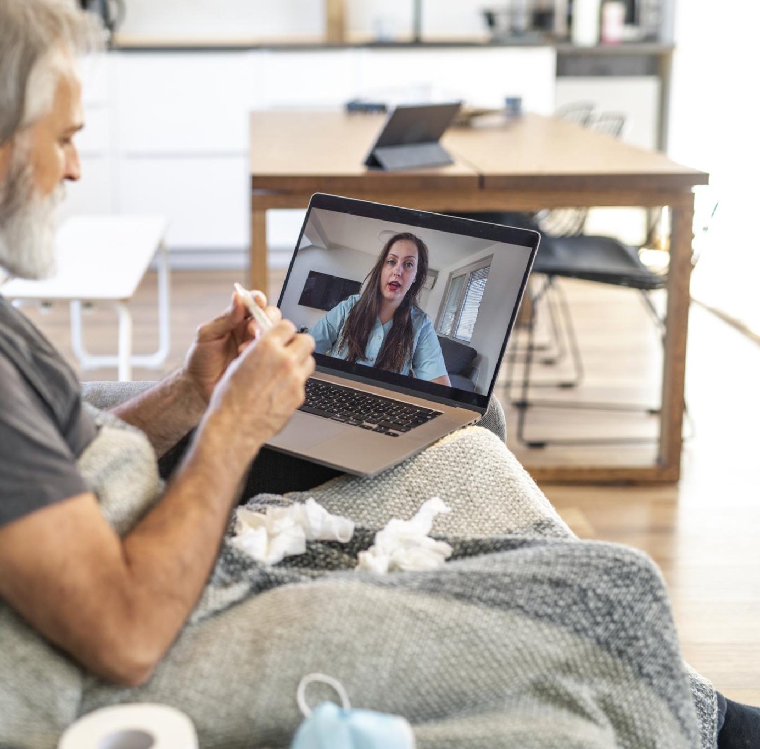
Virtual Companions and Chatbots for Combating Loneliness
AI Emotional Support
Virtual companions use AI to provide meaningful conversation and emotional support to seniors.
Reducing Loneliness
These virtual companions help reduce feelings of loneliness and social isolation among seniors.
Notes:
--- AI-driven virtual companions provide conversation and emotional support, helping to reduce feelings of loneliness and social isolation among seniors. Image source: Microsoft 365 content library

Slide 13
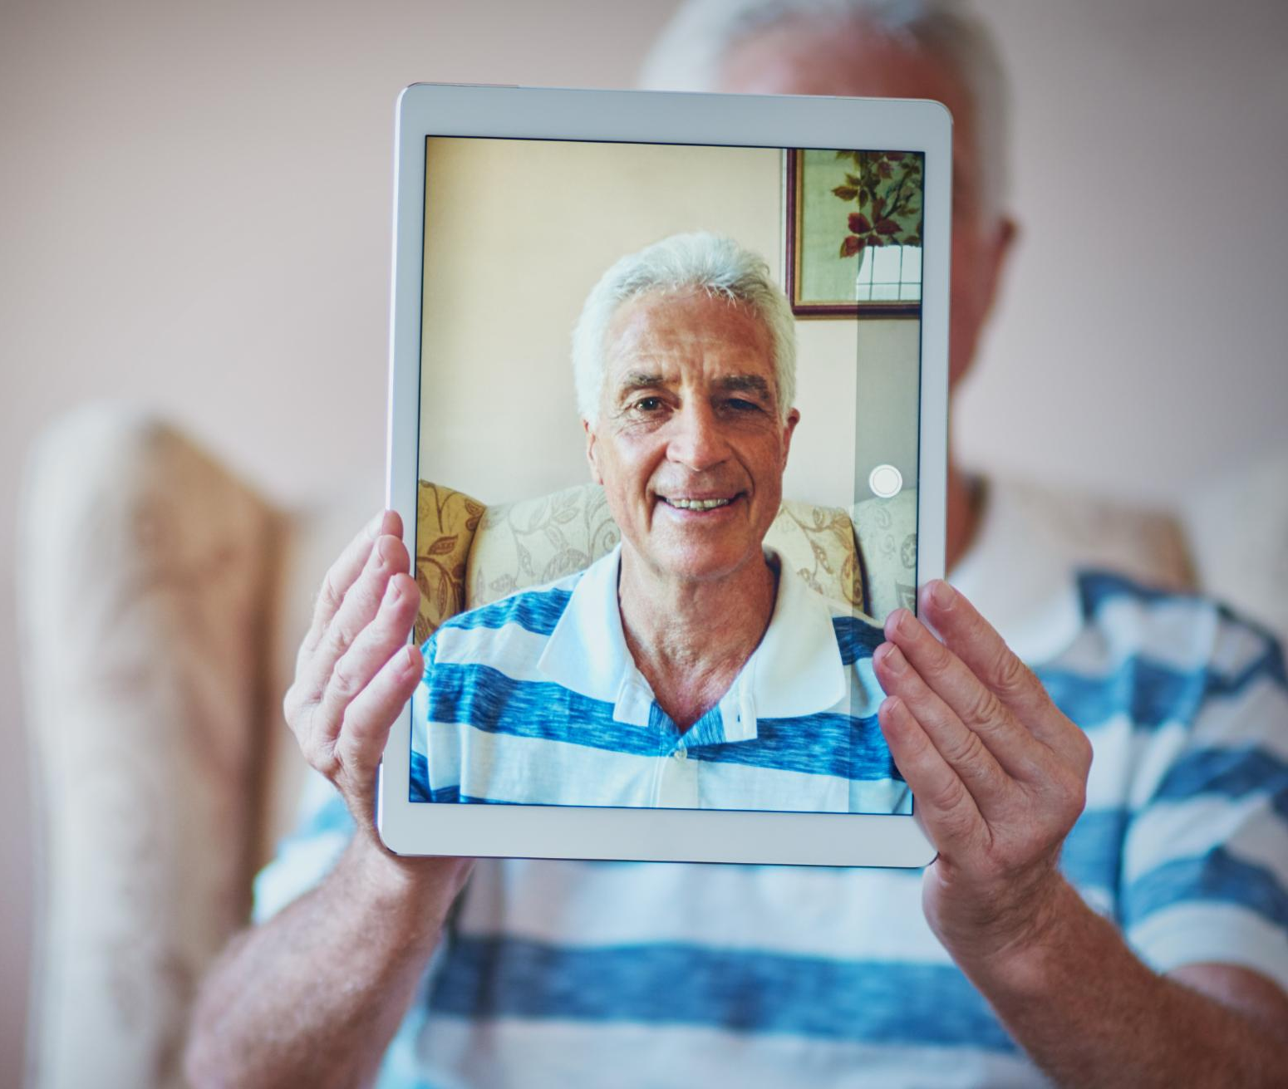
Online Platforms for Connecting with Family and Friends
AI-Powered Communication
AI enhances online tools making communication simple and accessible for seniors to connect with family and friends.
Video Calls and Messaging
User-friendly platforms enable easy video calling and messaging to maintain close connections with loved ones.
Senior-Friendly Social Networking
Social networking designed specifically for seniors encourages social interaction and combats isolation.
Notes:
--- AI powers user-friendly online tools that simplify connecting with loved ones through video calls, messaging, and social networking tailored for seniors. Image source: Microsoft 365 content library

Slide 14
AI-Driven Games and Cognitive Training
AI-Based Interactive Games
AI-driven games engage seniors with interactive activities that stimulate the brain and enhance mental agility.
Memory Retention Benefits
Brain-training programs improve seniors’ memory retention through repeated mental exercises and challenges.
Cognitive Health Improvement
Regular use of AI cognitive training supports overall cognitive health and delays mental decline in seniors.
Notes:
--- Interactive AI-based games and brain-training programs promote mental stimulation, memory retention, and cognitive health in seniors. Image source: Microsoft 365 content library

Slide 15
Supporting Caregivers and Family Members
ARTIFICIAL INTELLIGENCE –AI POWERED DEVICES-SUPPORT WHEN NEEDED.
Notes:
AI tools also aid caregivers by providing monitoring, communication, and data insights that improve the quality and coordination of care for seniors.

Slide 16
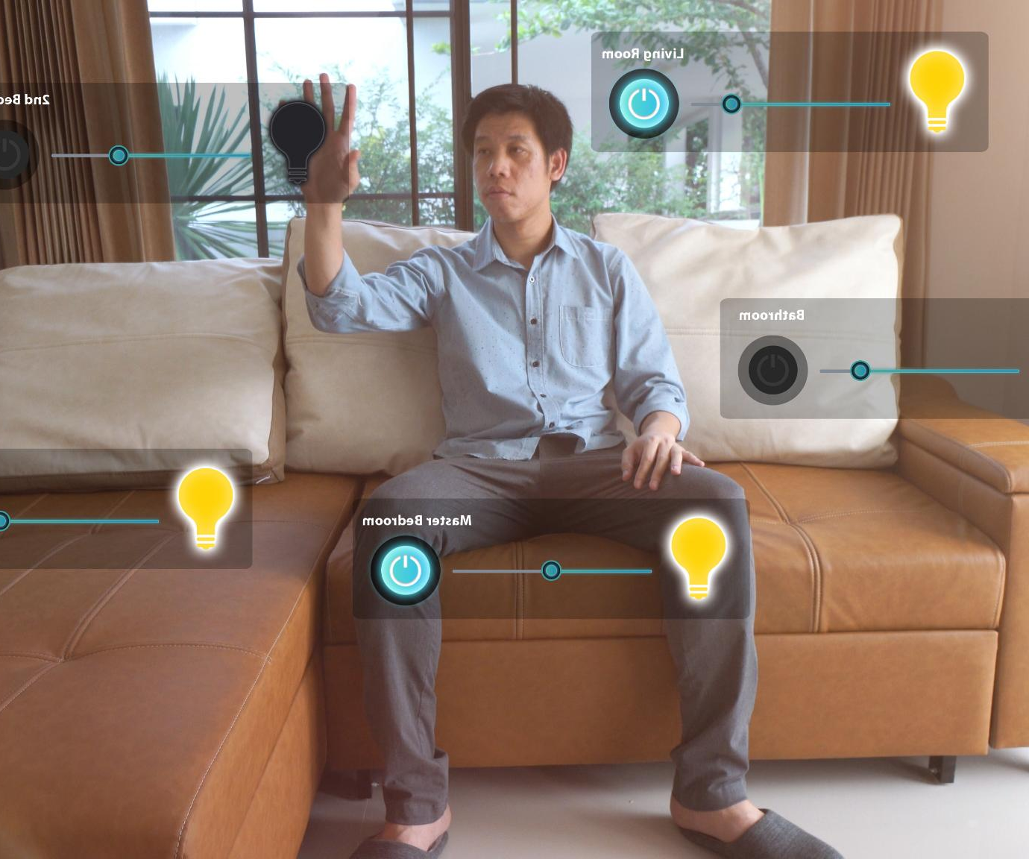
Monitoring Systems for Safety and Emergency Alerts
AI Monitoring for Seniors
Advanced AI systems continuously monitor seniors to ensure their safety and detect emergencies promptly.
Automatic Emergency Alerts
Systems instantly notify caregivers or emergency services when falls or urgent events occur.
Notes:
--- AI-enabled monitoring systems track seniors’ safety and automatically alert caregivers or emergency services in case of falls or other urgent events. Image source: Microsoft 365 content library

Slide 17

Communication Tools for Coordinating Care
AI-Enabled Communication
AI enhances communication efficiency among caregivers and healthcare providers, enabling timely and accurate information sharing.
Family Involvement
Communication tools empower family members to stay informed and involved in care decisions and updates.
Coordinated Support
Effective communication ensures coordinated care among all parties, improving patient outcomes and support quality.
Notes:
--- AI facilitates efficient communication among caregivers, family members, and healthcare providers to ensure coordinated and effective support. Image source: Microsoft 365 content library

Slide 18

Data-Driven Insights for Personalized Support
Sensor Data Collection
Sensors and devices collect real-time data to monitor seniors' health and activities continuously.
AI Data Analysis
AI analyzes vast amounts of sensor data to identify patterns and generate meaningful insights.
Personalized Care Plans
Insights from AI enable customizing care plans tailored to each senior's unique needs and preferences.
Notes:
--- By analyzing data collected from sensors and devices, AI provides insights that help tailor care plans to the unique needs of each senior. Image source: Microsoft 365 content library

Slide 19
Conclusion Artificial Intelligence (AI) is here!!! Seniors need to learn how to use it safely. .
Enhancing Independence
AI technologies empower seniors to live independently by assisting with daily tasks and safety monitoring.
Supporting Health
AI supports seniors' health through monitoring vital signs and managing medications effectively.
Fostering Social Connections
AI aids in maintaining social interaction for seniors, reducing isolation through communication tools.
Aiding Caregivers
AI technologies help caregivers by providing timely information and automating routine care tasks.
Notes:
Artificial intelligence offers numerous benefits for senior citizens by enhancing independence, supporting health, fostering social connections, and aiding caregivers. Embracing AI technologies can greatly improve the quality of life for older adults.

